Slide 1
Angular Services
Introduction

Slide 2
Services are key, the more the better?

Slide 3
Angular
1
Introduction

Slide 4
Introduction
Function, feature, helper, … that an application needs
Class with a well-defined purpose
Only do 1 thing, but do it great!
Adds modularity and reusability
Separates view-related functionality from other kinds of processing

Slide 5
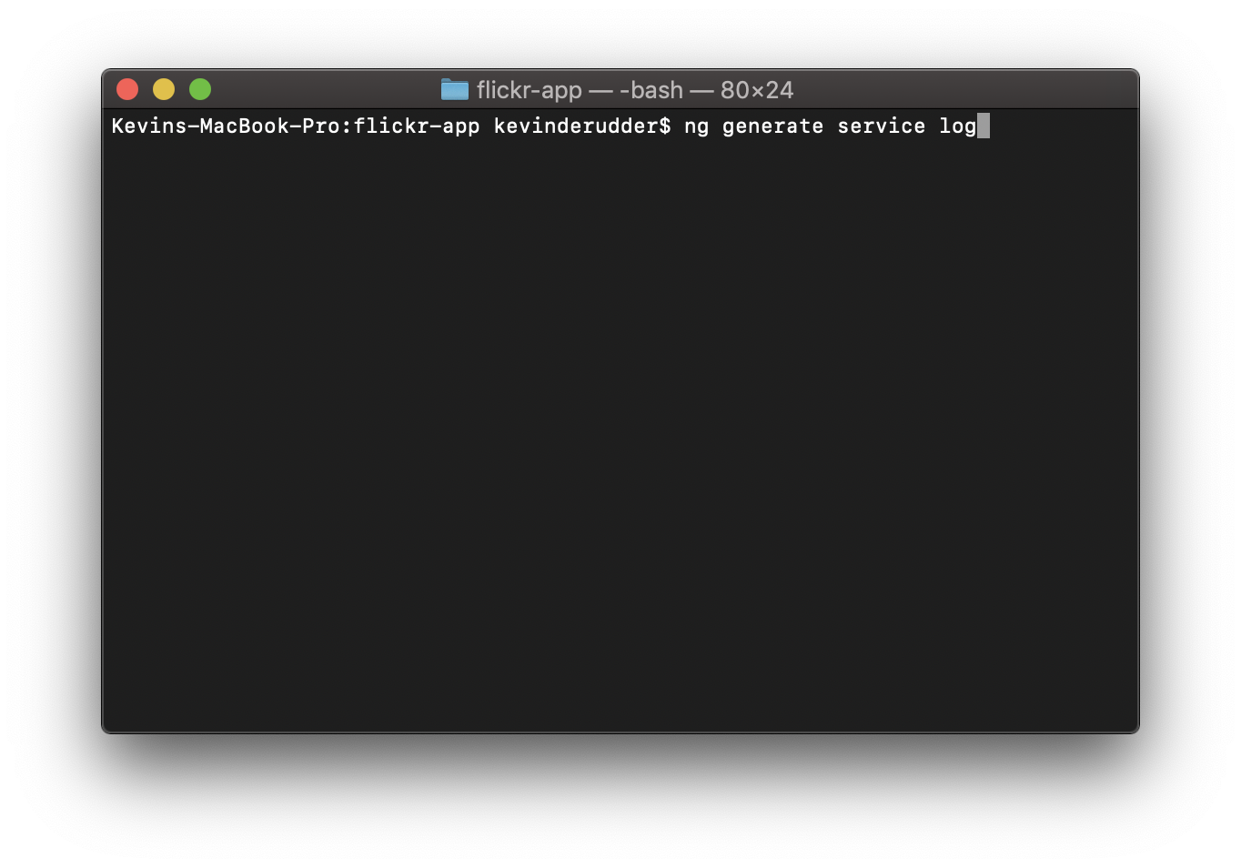

Slide 6
import { Injectable } from '@angular/core';
@Injectable({
providedIn: 'root'
})
export class LogService {
constructor() { }
}

Slide 7
import { Injectable } from '@angular/core';
@Injectable({
providedIn: 'root'
})
export class LogService {
constructor() { }
}
Dependency Injection

Slide 8
Angular
2
Injectable

Slide 9
Injectable
DI wired into Angular and used everywhere to provide components with services
@Injectable
Provides metadata to inject functionality
Angular creates an application-wide injector during the bootstrap process
Injector
Creates dependencies, and maintains a container of dependency instances for reusability
Provider
How to obtain or create a dependency

Slide 10
Using a service
constructor(private logService:LogService,
private router: Router,
private route: ActivatedRoute) {
/*…*/
}

Slide 11
Using a service
When Angular discovers a dependency, it checks if the injector has any existing instances of that service
Injector
PhotoService
LogService
HttpService
AuthService
WageService
Component

Slide 12
Angular
3
Providing Services

Slide 13
Providing Services
Minimum of 1 provider
Everywhere
Or in 1 component specific
By default, CLI registers a provider with the root injector
Single, shared instance
Injects in every requesting class
@Injectable({
providedIn: 'root'
})
Notes:
When you provide the service at the root level, Angular creates a single, shared instance of HeroService and injects it into any class that asks for it. Registering the provider in the @Injectable() metadata also allows Angular to optimize an app by removing the service from the compiled app if it isn't used.

Slide 14
Providing Services
Registering it for a component
New instance of the service with each new instance of that component
Notes:
When you provide the service at the root level, Angular creates a single, shared instance of HeroService and injects it into any class that asks for it. Registering the provider in the @Injectable() metadata also allows Angular to optimize an app by removing the service from the compiled app if it isn't used.

Slide 15
Providers
@NgModule({
declarations: [],
imports: [],
providers: [],
bootstrap: [AppComponent]
})
3 different scenarios
Eager
Lazy
Declarables (in component or directives)

Slide 16
Eager @NgModule
Registered as a global singleton
Even when included in components, services or directives
Only one instance will be created by the injector
Registered at the root

Slide 17
Lazy @NgModule
Instance of the service provided in the lazy module will be created on the child when initialized later during the run-time

Slide 18
Declarables @NgModule
Service is instantiated per component and is accessible in the component and all its child components
Service is not a singleton
@Component({
selector: 'app-photos-list',
providers: [LogService]
})
export class PhotosListComponent implements OnInit {

